Slide 1
Project 3:
“Bio-Inspired Optimization of the Traveling Salesman Problem”
John McClellan (Reading Community High School, Reading, OH)
Ryan Wright (Ryle High School, Union, KY)
Faculty Members: Dr. Kelly Cohen and Dr. Jeff Kastner
Graduate Research Assistant: Ms. Jutshi Agarwal
Notes:
Ryan & John : https://www.uc.edu/ucomm/brand.html

Slide 2
Table of Contents
Abstract Introduction Background Literature Review Main Goal Objectives & Research Tasks Research Timeline and Training Units Research Progress
Conclusions
Abstract
Introduction
Literature Review
Goals & Objectives
Research Training
Research Methods
Research Conclusions
Unit Design
Notes:
John

Slide 3
Abstract
“Genetic algorithms apply biological concepts to a guided programming search technique for intelligence systems. One such problem that can make use of such a tool is the Traveling Salesman Problem (TSP). By combining a 2-OPT approach with the genetic algorithms, new, more optimal ways to tackle this problem may become more evident…”
Abstract
Introduction
Literature Review
Goals & Objectives
Research Training
Research Methods
Research Conclusions
Unit Design
Notes:
John

Slide 4
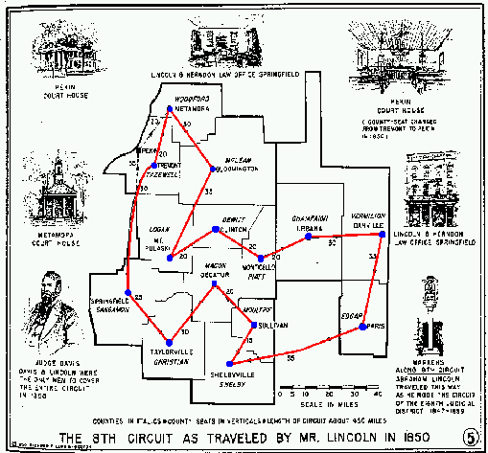
Introduction -
Traveling Salesman Problem (TSP)
What is the TSP?
Why the TSP?
Applications
Abstract
Introduction
Literature Review
Goals & Objectives
Research Training
Research Methods
Research Conclusions
Unit Design
http://www.math.uwaterloo.ca/tsp/gallery/igraphics/lincoln.html
Notes:
Ryan
Jutshi’s note: This would be a good place in presentation to add attention-grabbing pictures/notes (For final day presentation)

Slide 5
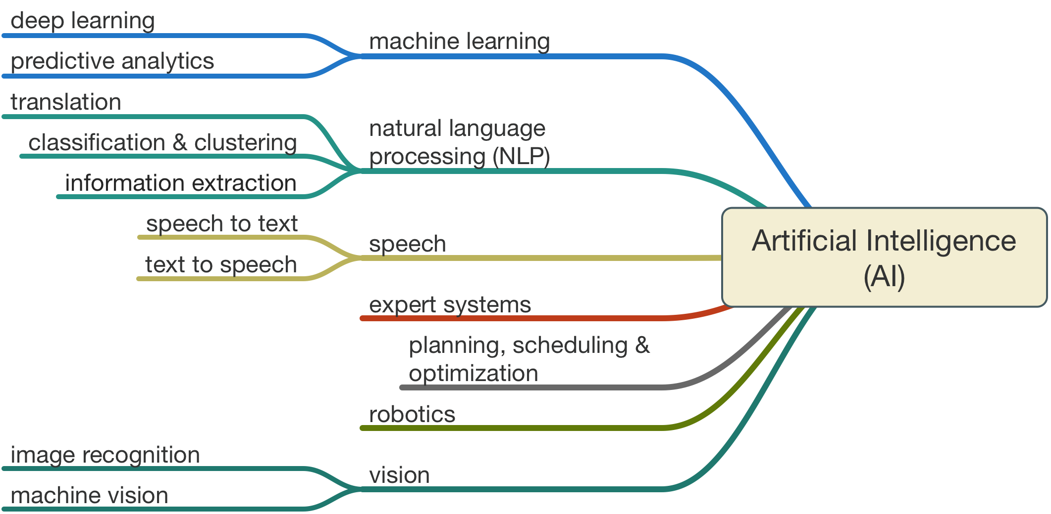
Introduction -
Artificial Intelligence (AI)
Abstract
Introduction
Literature Review
Goals & Objectives
Research Training
Research Methods
Research Conclusions
Unit Design
https://media.licdn.com/mpr/mpr/
Notes:
Ryan
Why AI? Problem Complexity, Time, Technological Advances

Slide 6
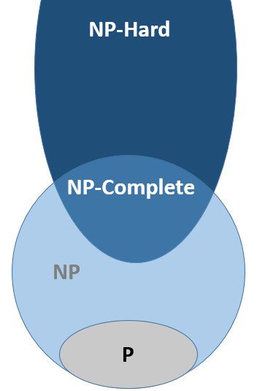
Literature Review:
The TSP
NP-hard
(n-1)!/2
3,038 cities have...
Abstract
Introduction
Literature Review
Goals & Objectives
Research Training
Research Methods
Research Conclusions
Unit Design
http://www.math.uwaterloo.ca/tsp/problem/pcb3cnt.html
http://aristotle2digital.blogwyrm.com/?p=384
Notes:
John: TSP -- Heuristic approaches since NP-hard (n-1)!/2

Slide 7
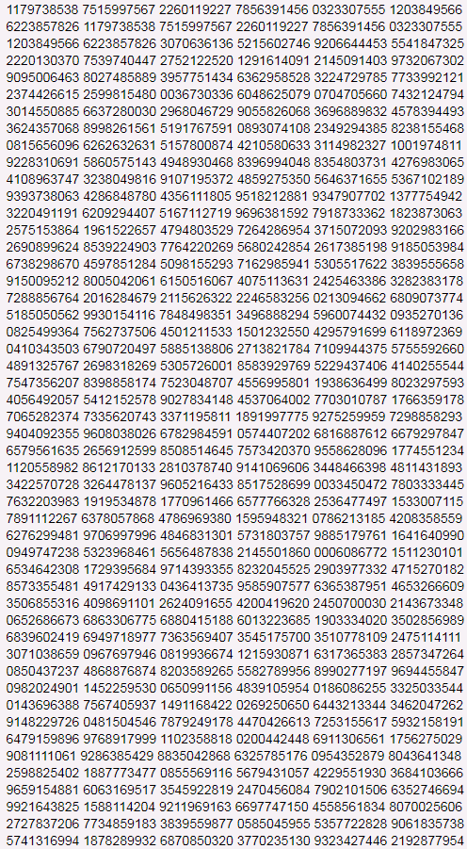
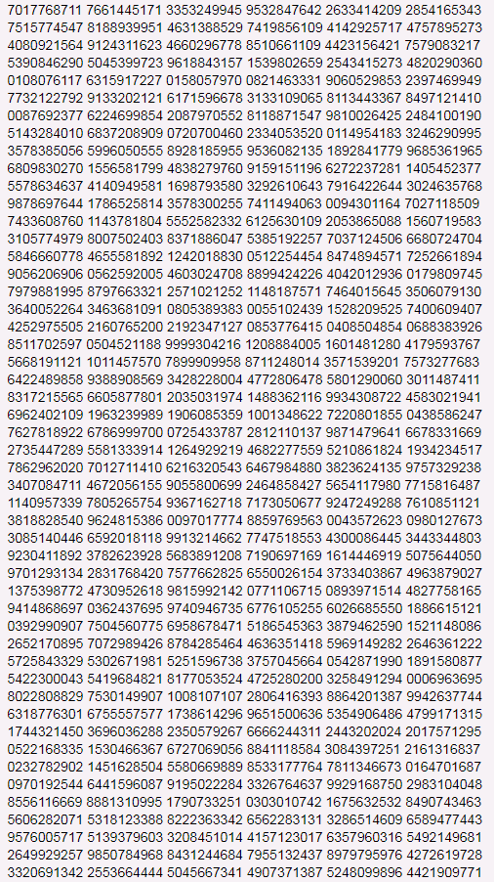
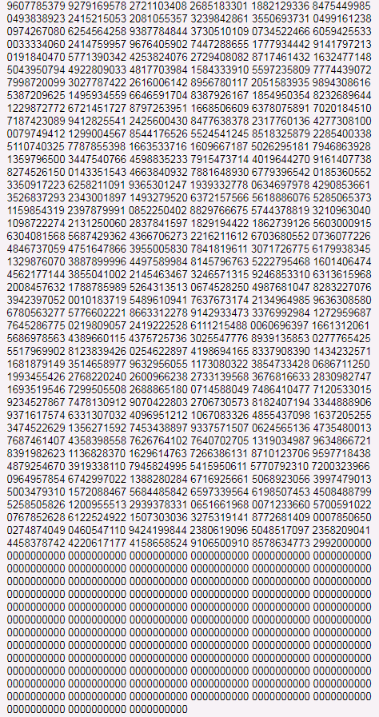
Notes:
John: 1.1179 x 10^9259 or ~10^10^5

Slide 8
Literature Review:
k-OPT Algorithms
Abstract
Introduction
Literature Review
Goals & Objectives
Research Training
Research Methods
Research Conclusions
https://hackaday.io/project/4955-g-code-optimization
Unit Design
Notes:
John: Converts problem to polynomial time -- still a heuristic approach

Slide 9
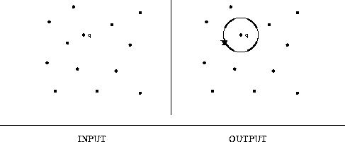
Literature Review:
Nearest Neighbor Approach
Abstract
Introduction
Literature Review
Goals & Objectives
Research Training
Research Methods
Research Conclusions
Unit Design
https://www8.cs.umu.se/kurser/TDBAfl/VT06/algorithms/BOOK/BOOK4/NODE188.HTM
Notes:
John: start in portland

Slide 10
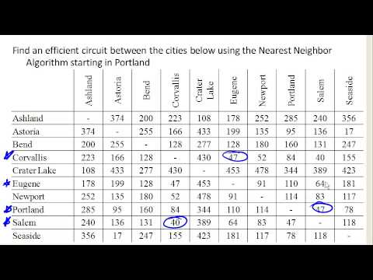
Literature Review:
Nearest Neighbor Approach
Abstract
Introduction
Literature Review
Goals & Objectives
Research Training
Research Methods
Research Conclusions
Unit Design
https://i.ytimg.com/vi/RK6eu3jvKzw/hqdefault.jpg
Notes:
John: start in portland

Slide 11
Literature Review:
Genetic Algorithms
Darwinian Principles
Selection, Recombination, Mutation, Migration
Abstract
Introduction
Literature Review
Goals & Objectives
Research Training
Research Methods
Research Conclusions
Unit Design
Notes:
Ryan:GA -- using darwinian structure to sort optimal algorithms

Slide 12
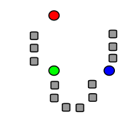
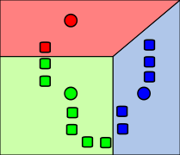
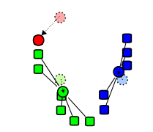
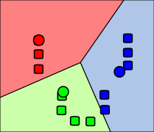
Literature Review:
Clustering Methods
Abstract
Introduction
Literature Review
Goals & Objectives
Research Training
Research Methods
Random “Means” Initial Clusters Centroid Comparison New Clusters
Research Conclusions
Unit Design
https://en.wikipedia.org/wiki/K-means_clustering#/media/File:K_Means_Example_Step_1.svg
Notes:
Ryan

Slide 13
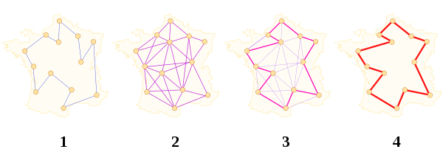
Main Goal
To develop a hybrid algorithm that can produce approximate solutions to the TSP efficiently.
Abstract
Introduction
Literature Review
Goals & Objectives
Research Training
Research Methods
Research Conclusions
Unit Design
https://en.wikipedia.org/wiki/Travelling_salesman_problem#/media/File:Aco_TSP.svg
Notes:
Ryan

Slide 14
Objectives & Research Tasks
Understand code written in MATLAB
Learn GA and 2-OPT algorithms for solving TSP
Create & test hybrids
Analyze the results
Abstract
Introduction
Literature Review
Goals & Objectives
Research Training
Research Methods
Research Conclusions
Unit Design
Notes:
Ryan
Matlab -- programming software that specializes in Matrices
Algorithms -- thoroughly understand at this point
Hybrids -- only have two hybrid variants
Analyze -- shortened total distances and average total computing time

Slide 15
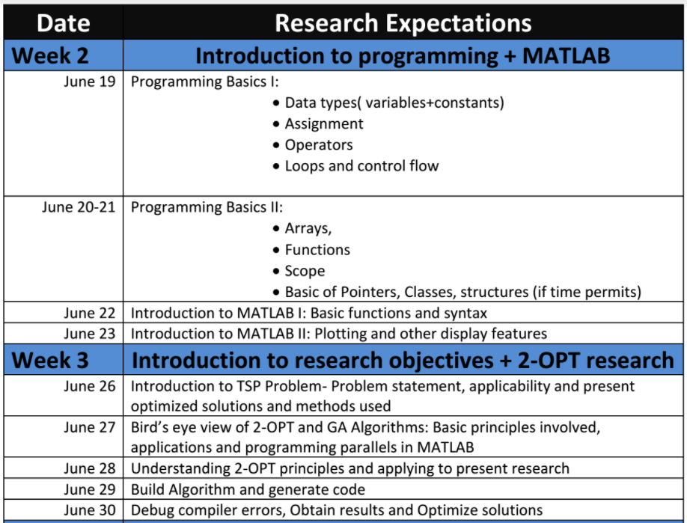
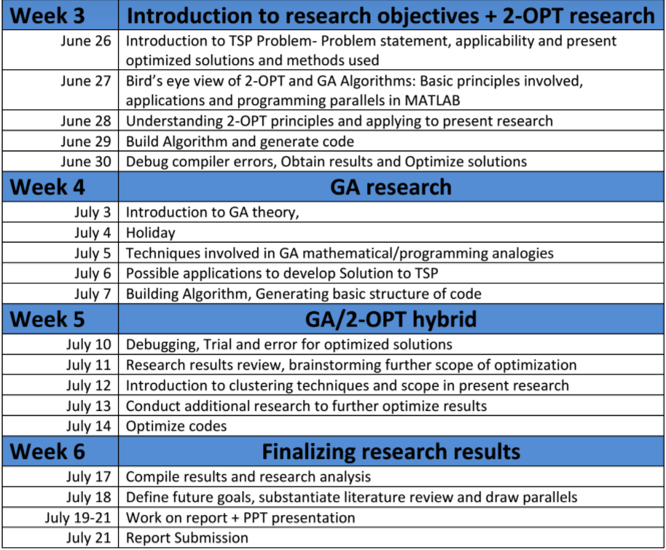
Research Timeline and Training
Introduction to Programing
MATLAB Syntax
Overview of TSP
Overview of GA and k-OPT
Abstract
Introduction
Literature Review
Goals & Objectives
Research Training
Research Methods
Research Conclusions
Unit Design
Notes:
John

Slide 16
Research Methods:
2-OPT
Abstract
Introduction
Literature Review
Goals & Objectives
Research Training
Research Methods
Research Conclusions
Unit Design
Notes:
John

Slide 17
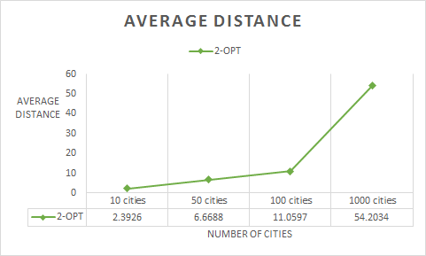
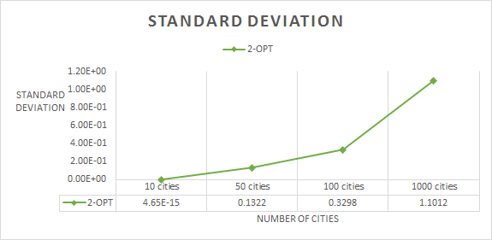
Research Methods:
2-OPT
Abstract
Introduction
Literature Review
Goals & Objectives
Research Training
Research Methods
Research Conclusions
Unit Design
Notes:
John

Slide 18
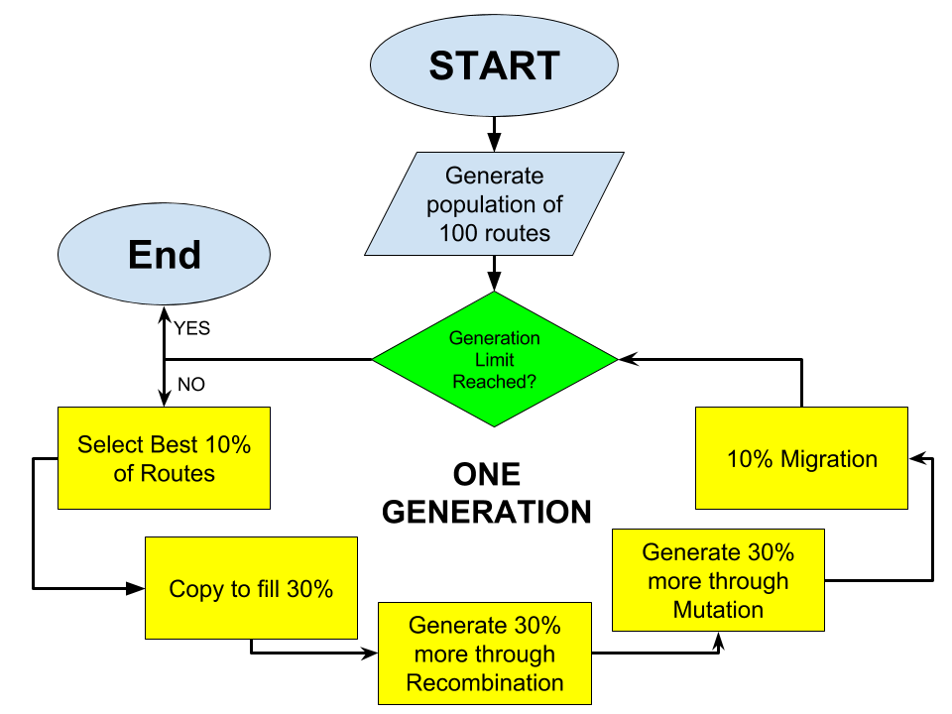
Research Methods: GA creation
Abstract
Introduction
Literature Review
Goals & Objectives
Research Training
Research Methods
Research Conclusions
Unit Design
Notes:
Ryan

Slide 19
Research Methods:
Optimizing the GA
Mutation rate
Recombinant length/locations
How selective
Generations
Abstract
Introduction
Literature Review
Goals & Objective
Research Training
Research Methods
Research Conclusions
Unit Design
Notes:
Ryan

Slide 20
Research Methods:
Optimizing the GA
 | Average Distance |  | Average Distance |  | Average Distance
Mutation=1/4 | 17.61 | Recomb=50% | 18.02 | Selection= Top 10% | 11.72
Mutation=1/6 | 17.59 | Recomb=40% | 17.29 | Selection= Top 15% | 12.15
Mutation=1/8 | 17.04 | Recomb=30% | 16.86 | Selection= Top 20% | 15.98
Mutation=1/10 | 16.92 | Recomb=20% | 16.11 | Selection= Top 30% | 17.54
Mutation=1/20 | 16.72 | Recomb=15% | 15.53 | Selection= Top 40% | 17.66
Mutation=1/40 | 17.12 | Recomb=10% | 15.94 | Selection= 5-35% | 17.61
Mutation=1/60 | 17.27 | Recomb=5% | 16.86 | Selection= 10-40% | 18.2
Abstract
Introduction
Literature Review
Goals & Objectives
Research Training
Research Methods
Research Conclusions
GA tested: | Average Distance Produced:
Initial GA (Mutation 1/6, Recomb 40%, Select top 30%) | 17.46
Optimized GA (Mutation 1/20, Recomb 15%, Select top 10%) | 11.61
Unit Design
Notes:
Ryan

Slide 21
Research Methods:
Running GA
Abstract
Introduction
Literature Review
Goals & Objectives
Research Training
Research Methods
Research Conclusions
Unit Design
Notes:
Ryan

Slide 22
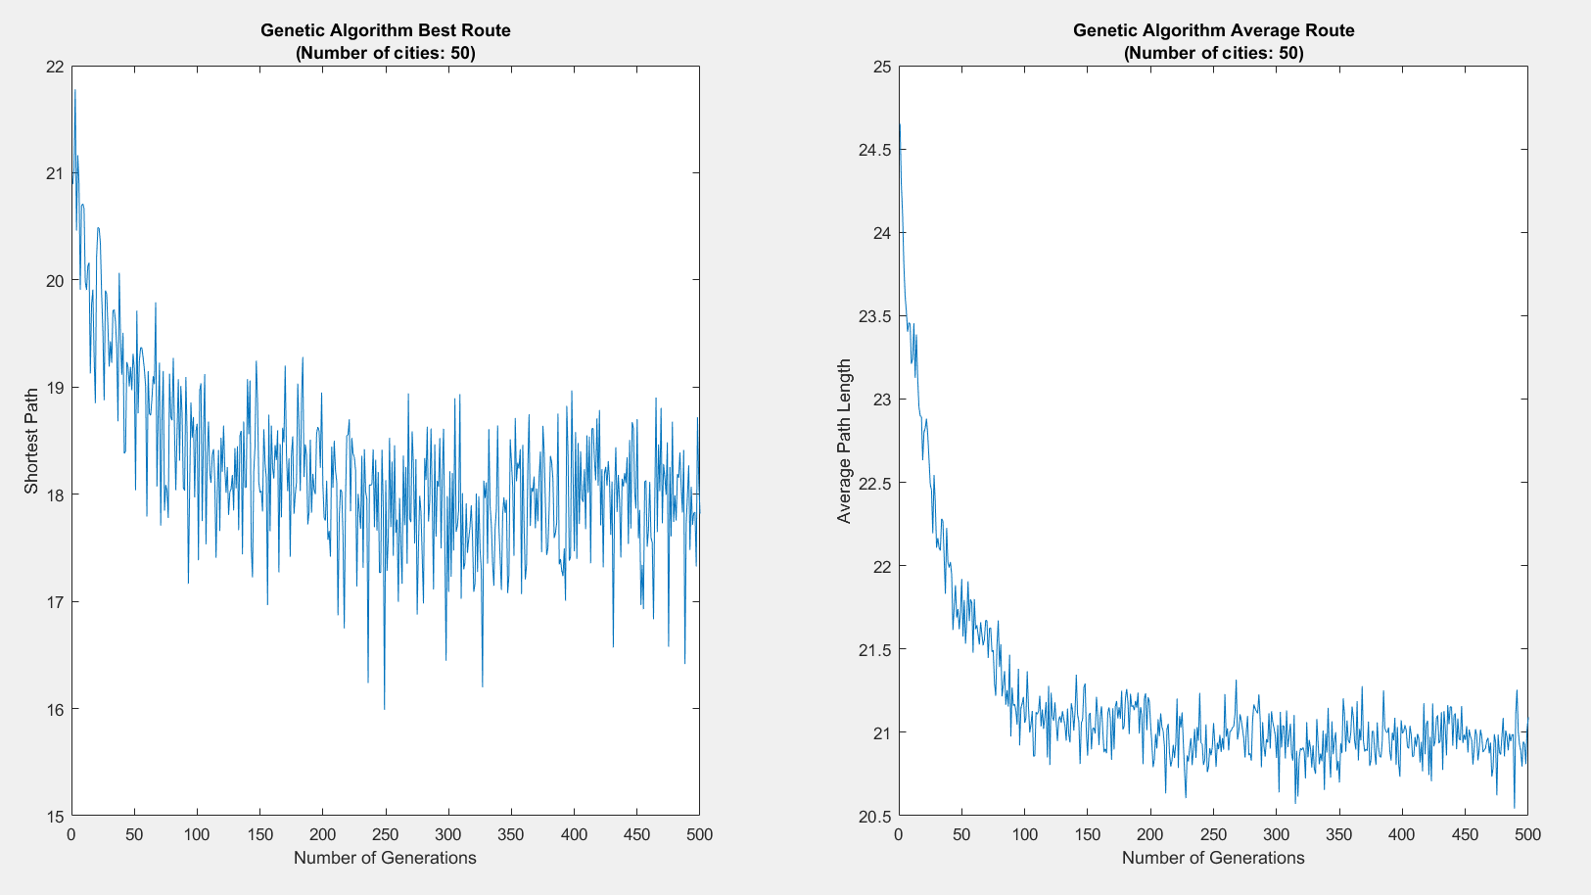
Research Methods:
Running GA
Abstract
Introduction
Literature Review
Goals & Objectives
Research Training
Research Methods
Research Conclusions
Unit Design
Notes:
Ryan

Slide 23
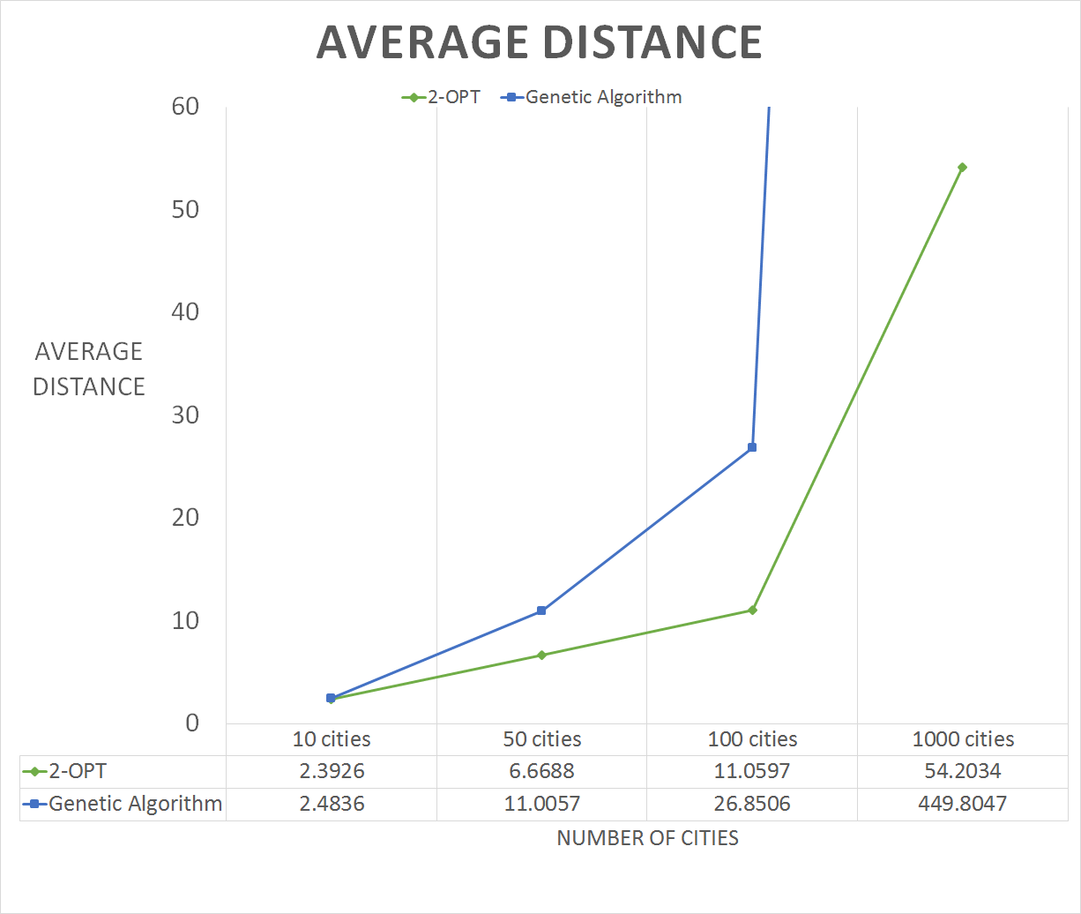
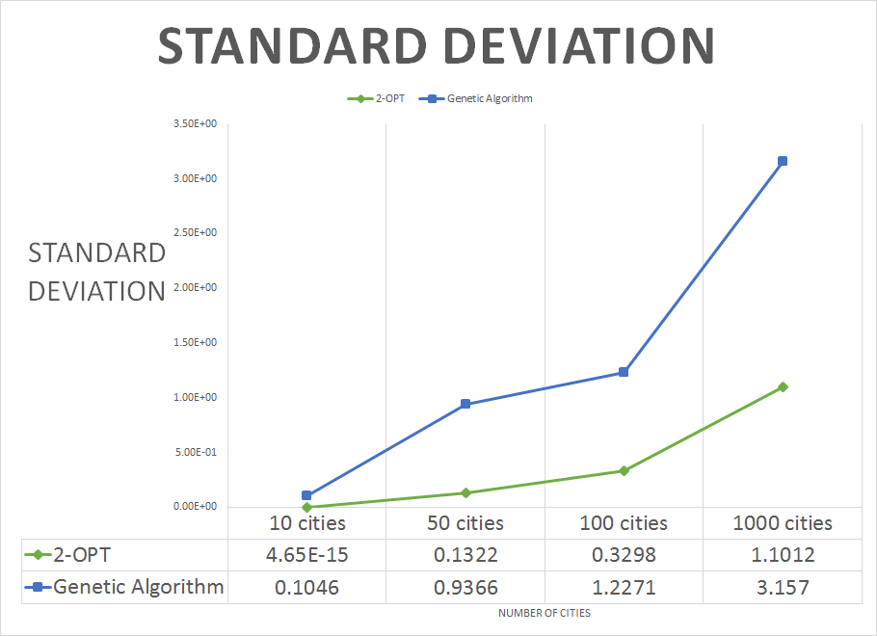
Research Methods:
GA Results
Abstract
Introduction
Literature Review
Goals & Objectives
Research Training
Research Methods
Research Conclusions
Unit Design
Notes:
Ryan

Slide 24
Research Methods:
Creating a Hybrid Algorithm
Replace Migration with 2-OPT
Apply Clustering
Adjust Percentages?
Abstract
Introduction
Literature Review
Goals & Objectives
Research Training
Research Methods
Research Conclusions
Unit Design
Notes:
John

Slide 25
Research Methods:
Running Hybrid Algorithm
Abstract
Introduction
Literature Review
Goals & Objective
Research Trainings
Research Methods
Research Conclusions
Unit Design
Notes:
John

Slide 26
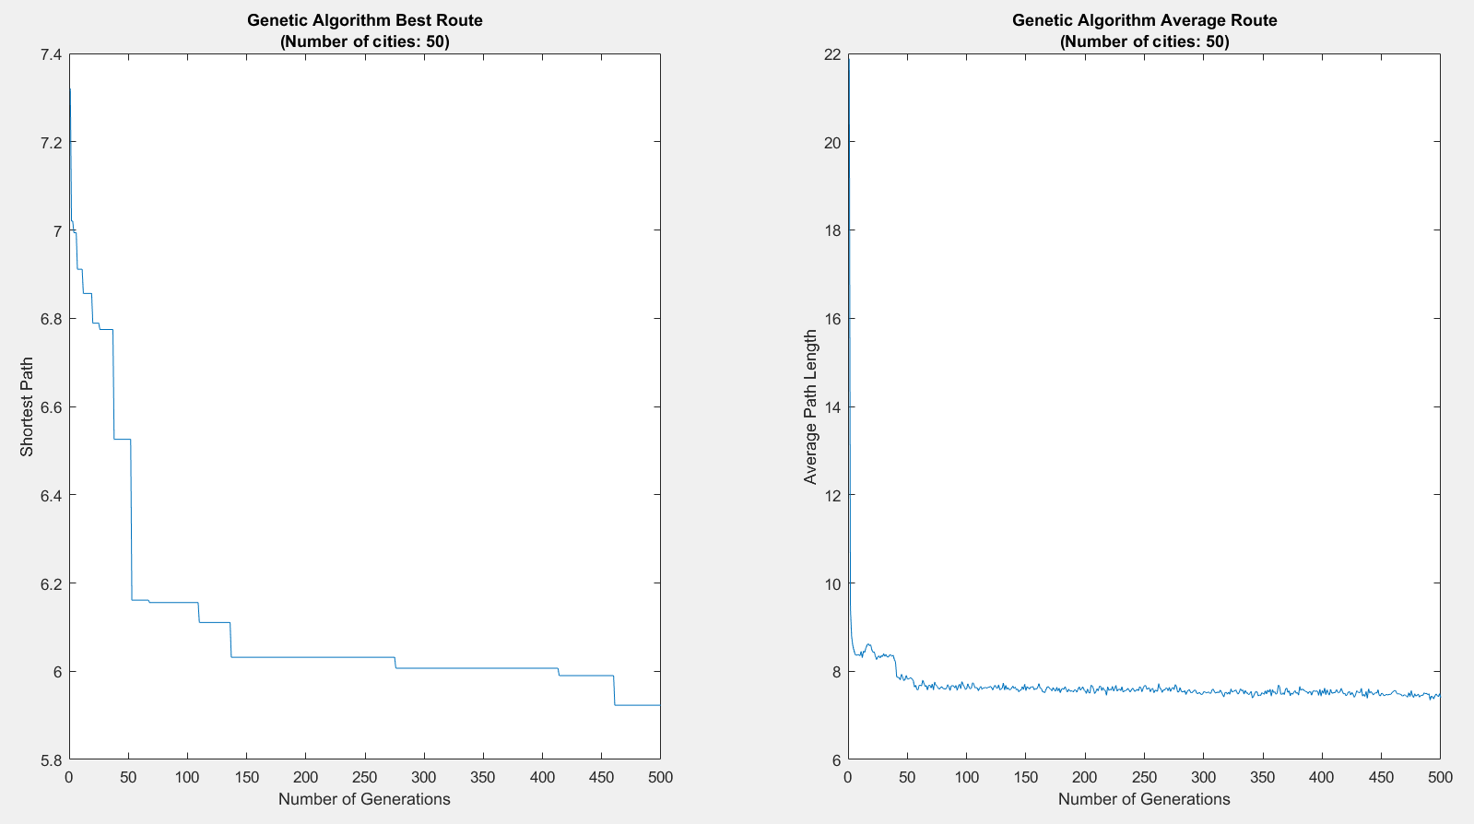
Research Methods:
Running Hybrid Algorithm
Abstract
Introduction
Literature Review
Goals & Objectives
Research Training
Research Methods
Research Conclusions
Unit Design
Notes:
John

Slide 27
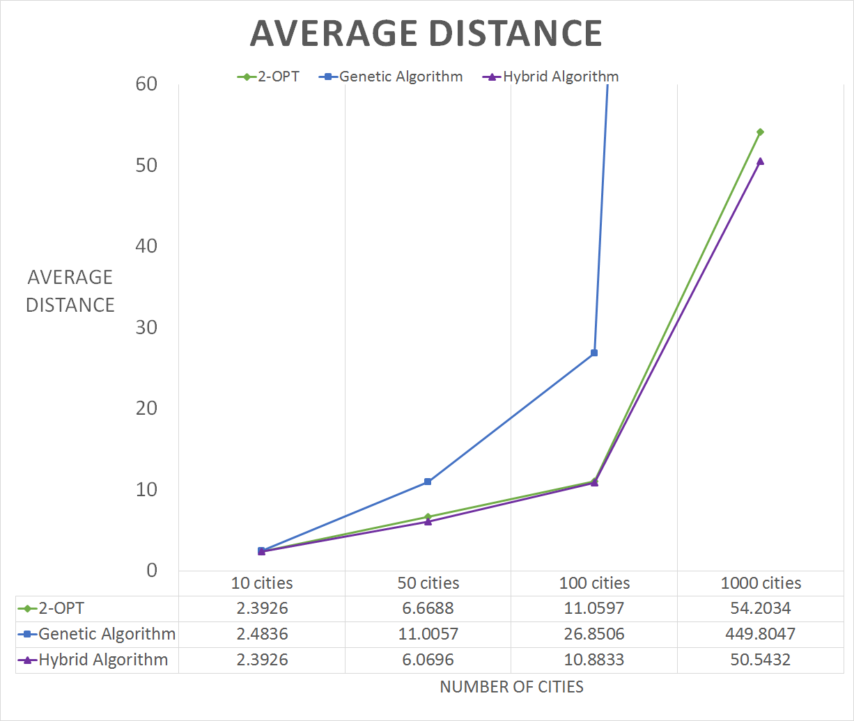
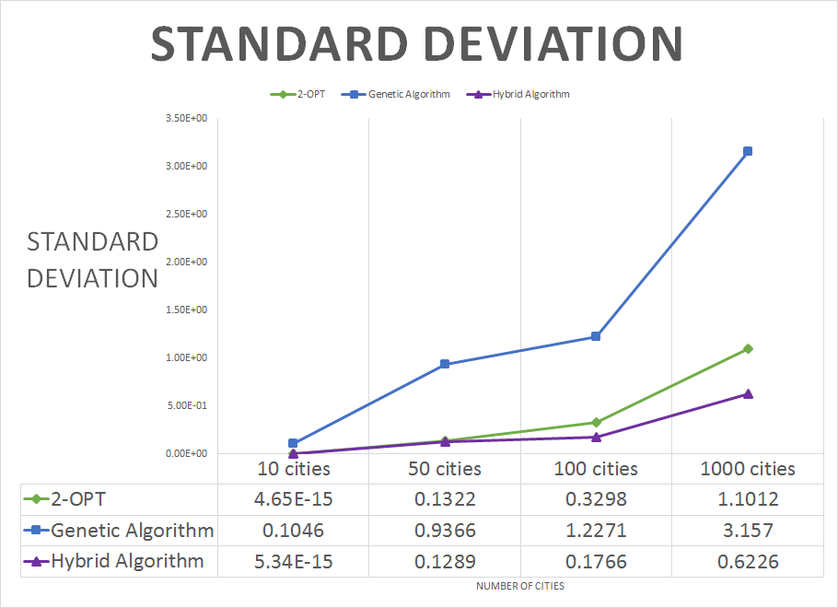
Research Methods:
Hybrid Algorithm
Abstract
Introduction
Literature Review
Goals & Objectives
Research Training
Research Methods
Research Conclusions
Unit Design
Notes:
John

Slide 28
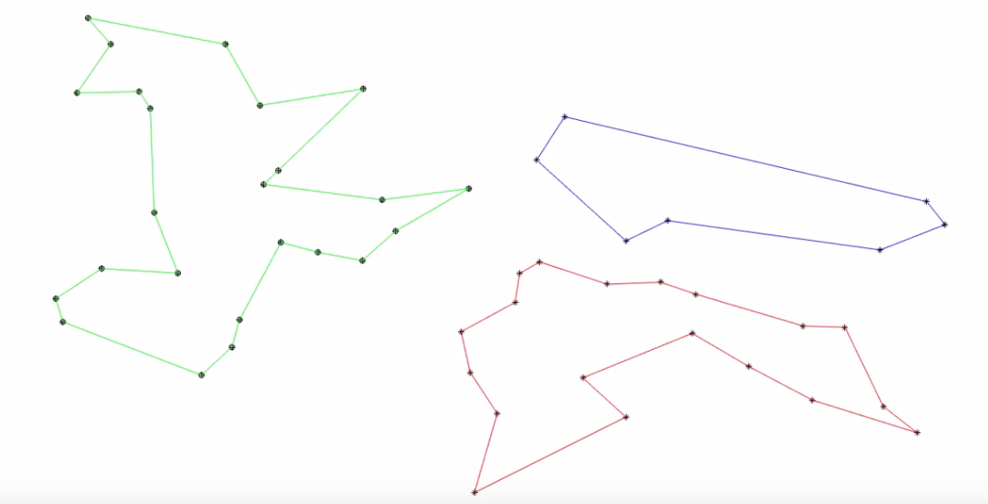
Research Methods:
Clustering
Abstract
Introduction
Literature Review
Goals & Objectives
Research Training
Research Methods
Research Conclusions
Unit Design
Notes:
John

Slide 29
Research Methods:
Clustering vs. Non-clustering
2-OPT vs. Clustering as a Baseline of Comparative Study:
Abstract
 | 2-OPT (Random) | 2-OPT (NN) | 2 Clusters (Random) | 2 Clusters (NN) | 3 Clusters (Random) | 3 Clusters (NN)
Time (secs) | 0.1599 | 0.1279 | 0.5643 | 0.6047 | 0.3542 | 0.5834
Min Distance | 6.7347 | 5.9152 | 6.3028 | 6.1582 | 6.0155 | 5.7115
Introduction
Literature Review
Goals & Objectives
Research Training
Research Methods
Research Conclusions
50 cities, 100 iterations
Unit Design
Notes:
John

Slide 30
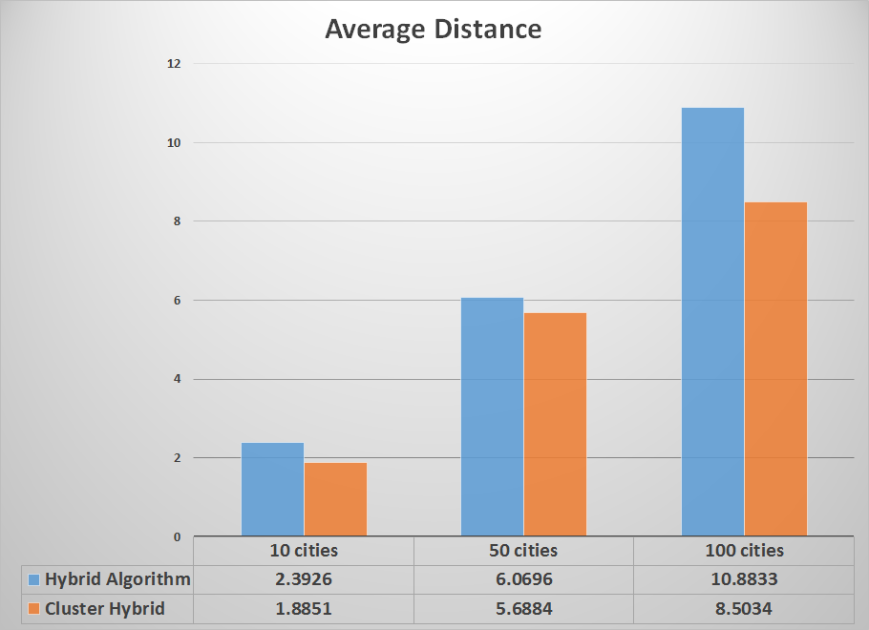
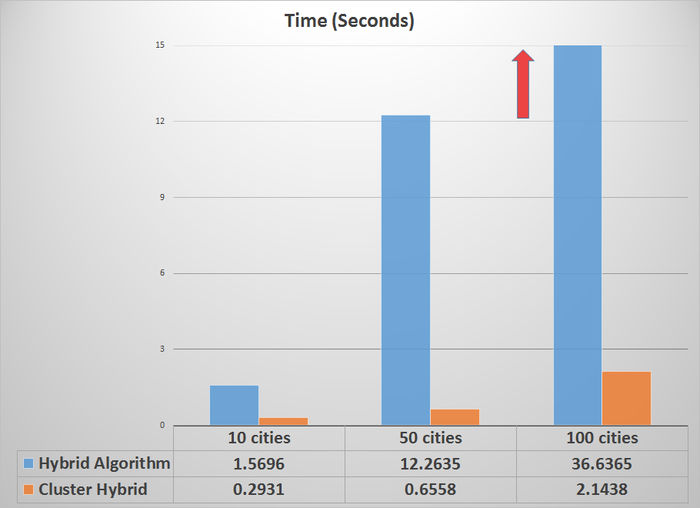
Research Methods:
Clustering vs. Non-clustering
Clustering vs Non-clustering in the Hybrid Algorithm:
Abstract
Introduction
Literature Review
Goals & Objectives
Research Training
Research Methods
Research Conclusions
Unit Design
Notes:
John

Slide 31
Conclusions: Research
Best results = Hybrid
Quickest = 2-OPT
Best option depends on application!
Clustering = YES
Abstract
Introduction
Literature Review
Goals & Objective
Research Training
Research Methods
Research Conclusions
Unit Design
Notes:
Ryan

Slide 32
Conclusions:
Goals and Objectives
Understand code written in MATLAB?
Learn GA and 2-OPT algorithms?
Create, test, and analyze hybrids?
Develop a hybrid algorithm that can produce approximate solutions to the TSP efficiently?
Abstract
Introduction
Literature Review
Goals & Objective
Research Training
Research Methods
Research Conclusions
Unit Design
Notes:
Ryan

Slide 33
John’s Unit
Big Idea: Computer Programming
Essential Question: How do computers think?
Challenge: Use Scratch to design an automated character to run a task within a certain time limit.
Abstract
Introduction
Literature Review
Goals & Objectives
Research Training
Research Methods
http://robotixinstitute.com/product/scratch/
Research Conclusions
Unit Design
Notes:
John

Slide 34
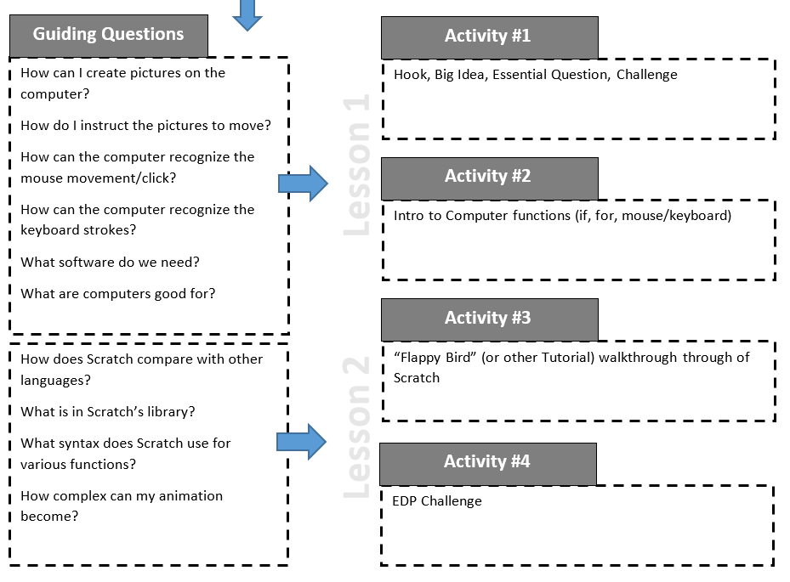
John’s Unit (cont.)
Abstract
Introduction
Literature Review
Goals & Objectives
Research Training
Research Methods
Research Conclusions
Unit Design
Notes:
John

Slide 35
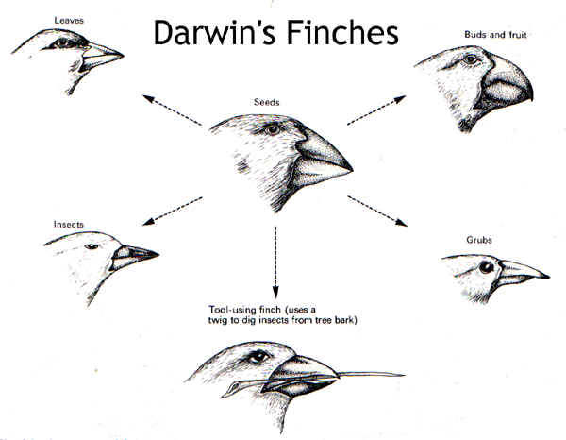
Ryan’s Unit
Big Idea: Natural Selection
Essential Question: How is life optimized by natural forces to be the best at surviving in its particular niche?
Challenge: Create a system (flow chart or algorithm) that shows the process of how nature optimizes life through natural selection.
Abstract
Introduction
Literature Review
http://evolution101.yolasite.com/natural-selection.php
Goals & Objectives
Research Training
Research Methods
Research Conclusions
Unit Design
https://www.123rf.com/photo_11901045_business-man-hand-drawing-flow-chart-isolated.html
Notes:
Ryan

Slide 36
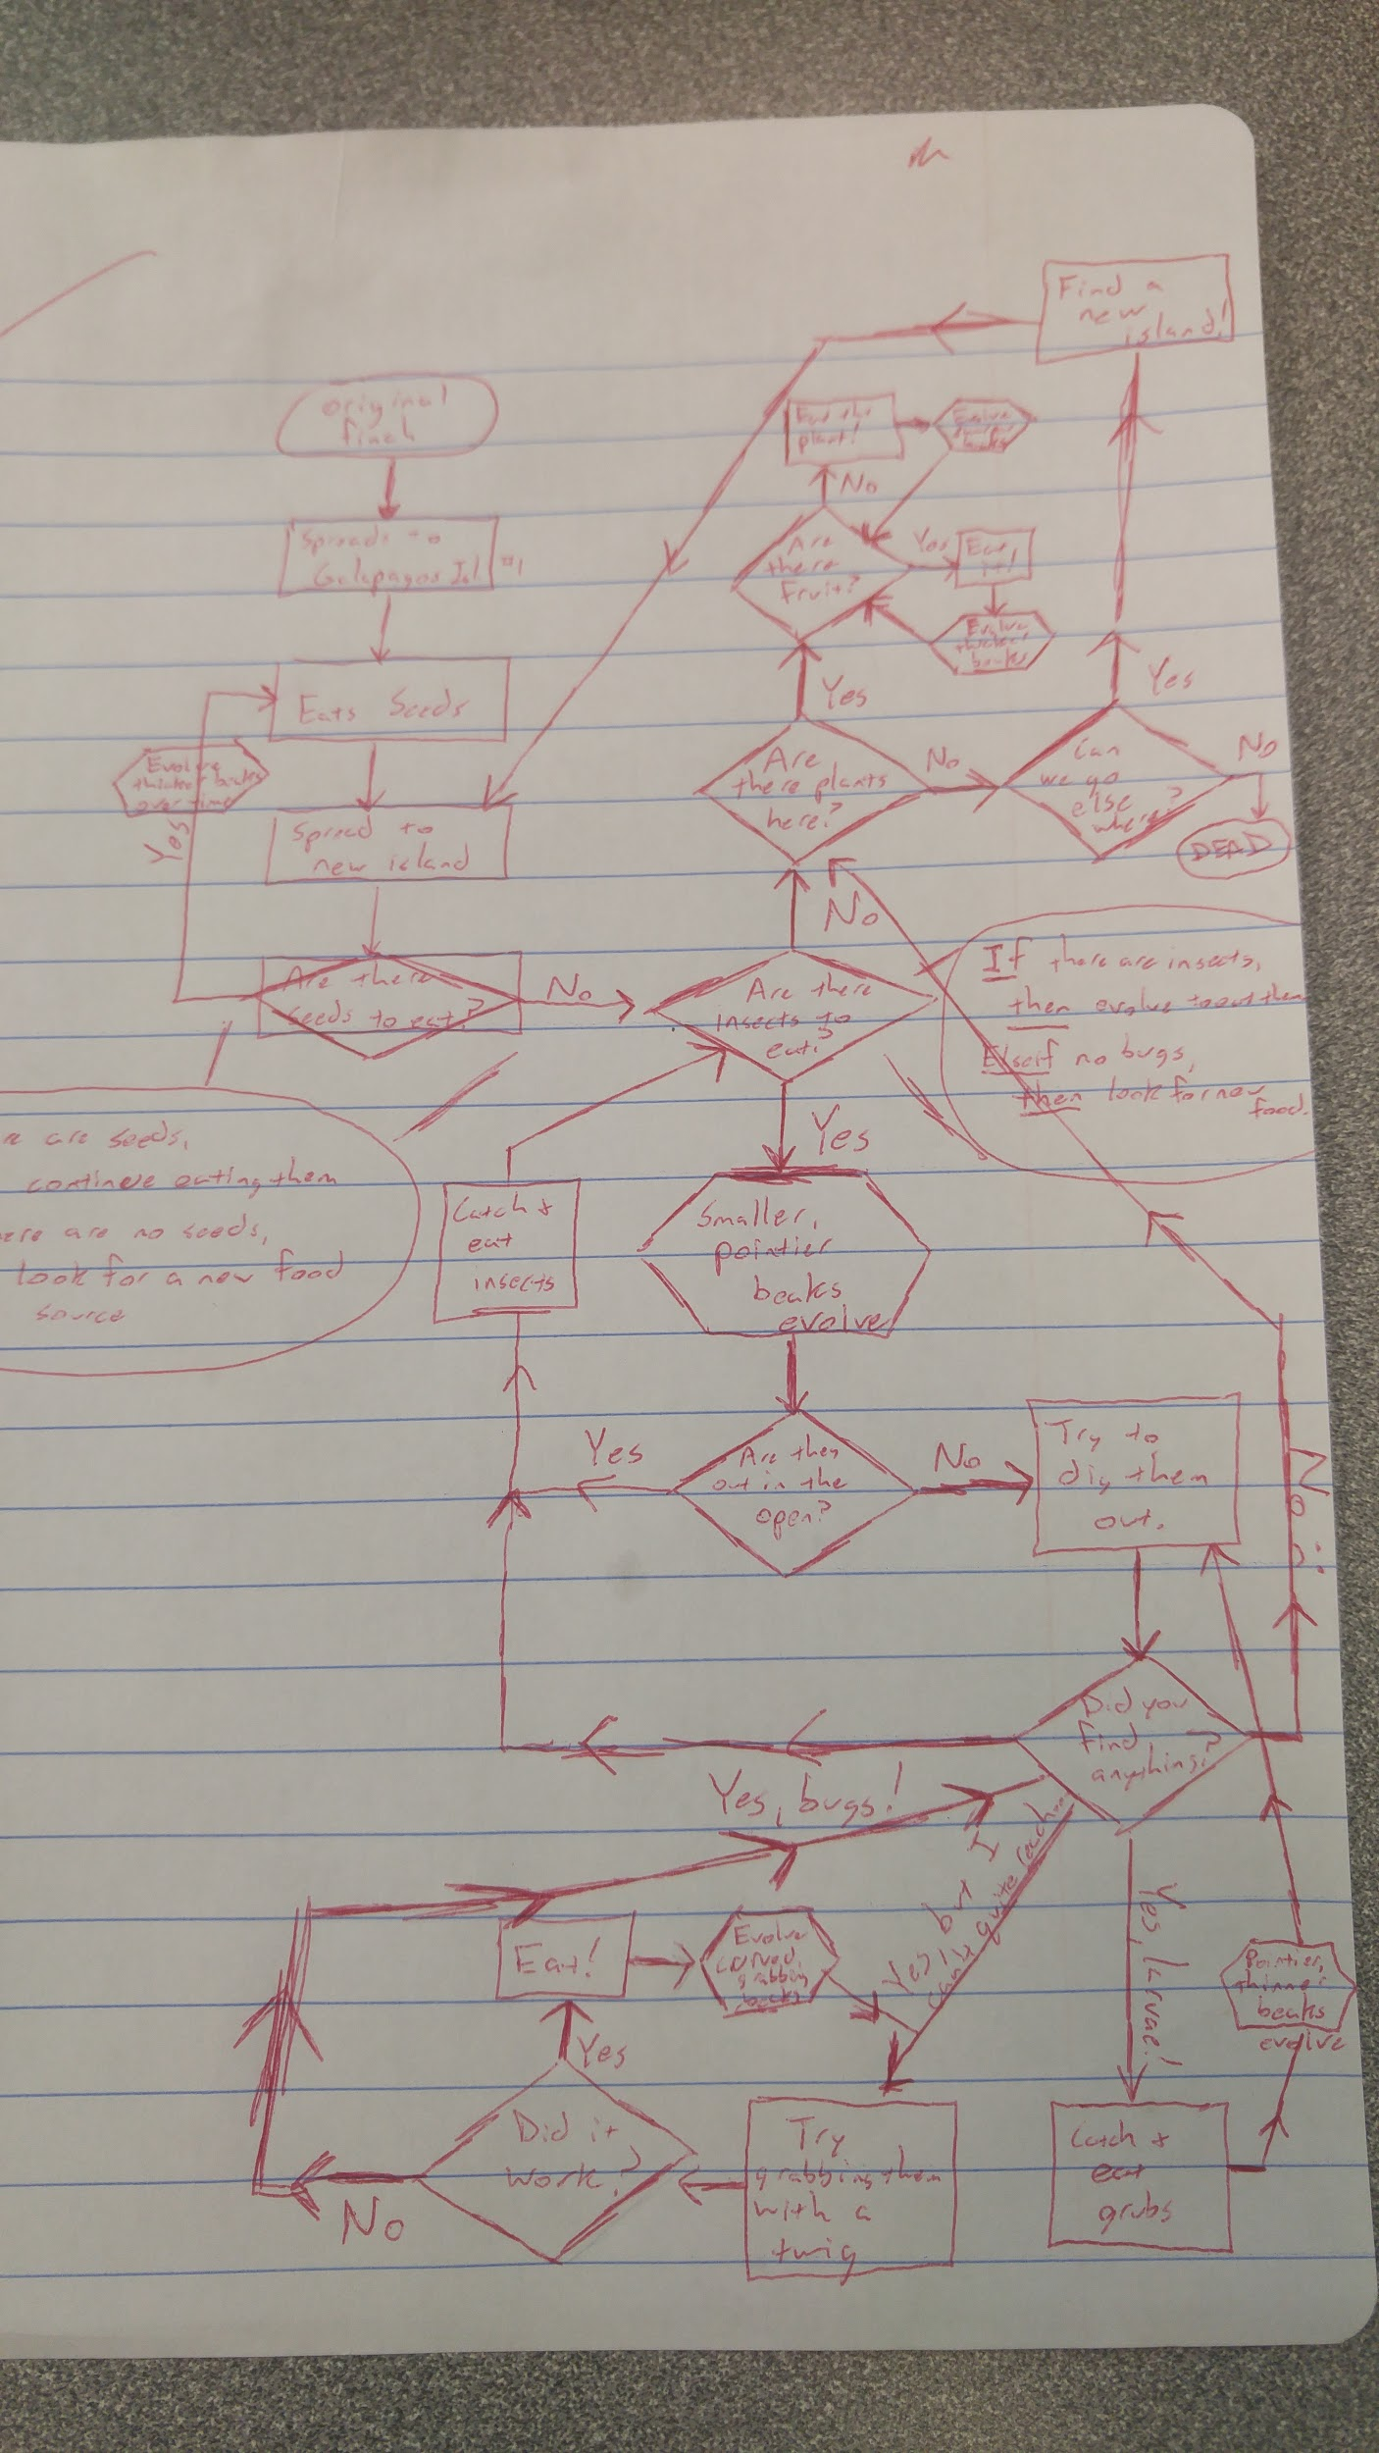
Ryan’s Unit (cont.)
Gather info, ID alternatives: Select & implement
solution
Research organisms,
come up with multiple things
that could have caused
splits.
Abstract
Introduction
Define
Problem:
Literature Review
Goals & Objectives
Evaluate
Solution:
Research Training
New conditions/
organisms added
Research Methods
http://evolution101.yolasite.com/natural-selection.php
Research Conclusions
Unit Design
Communicate:
Refine:
Share with class:
Poster and Powerpoint
Refine/improve
original solution
Notes:
Ryan

Slide 37
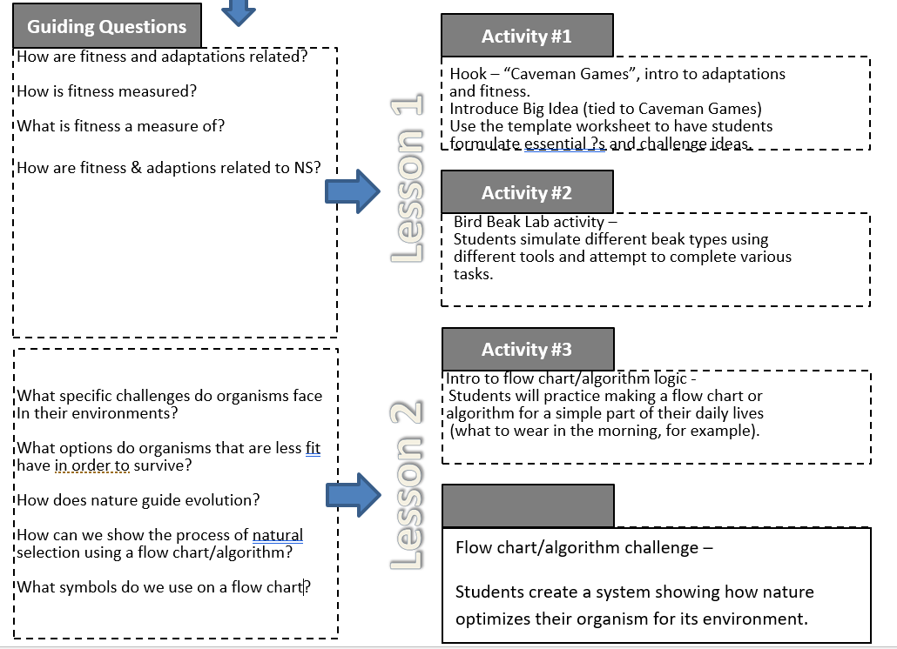
Ryan’s Unit (cont.)
Abstract
Introduction
Literature Review
Goals & Objectives
Research Training
Research Methods
Research Conclusions
Unit Design
Notes:
Ryan

Slide 38
Any Questions?
Abstract
Introduction
Thank you for your time!
Literature Review
Goals & Objectives
Research Training
Research Methods
Research Conclusions
Unit Design
Notes:
John & Ryan

